Slide 8
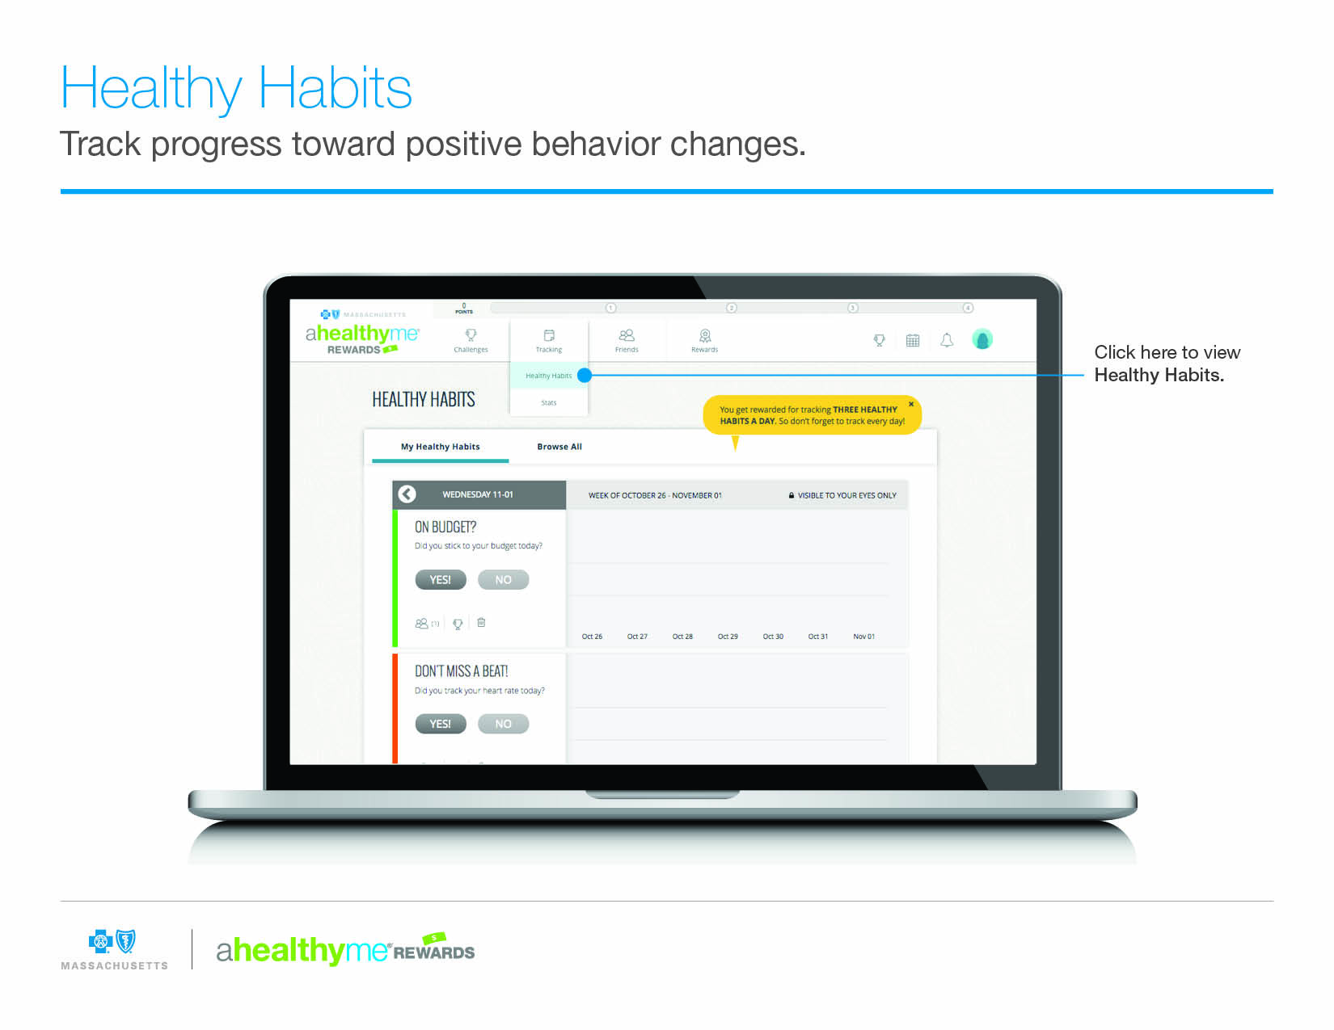

Slide 9
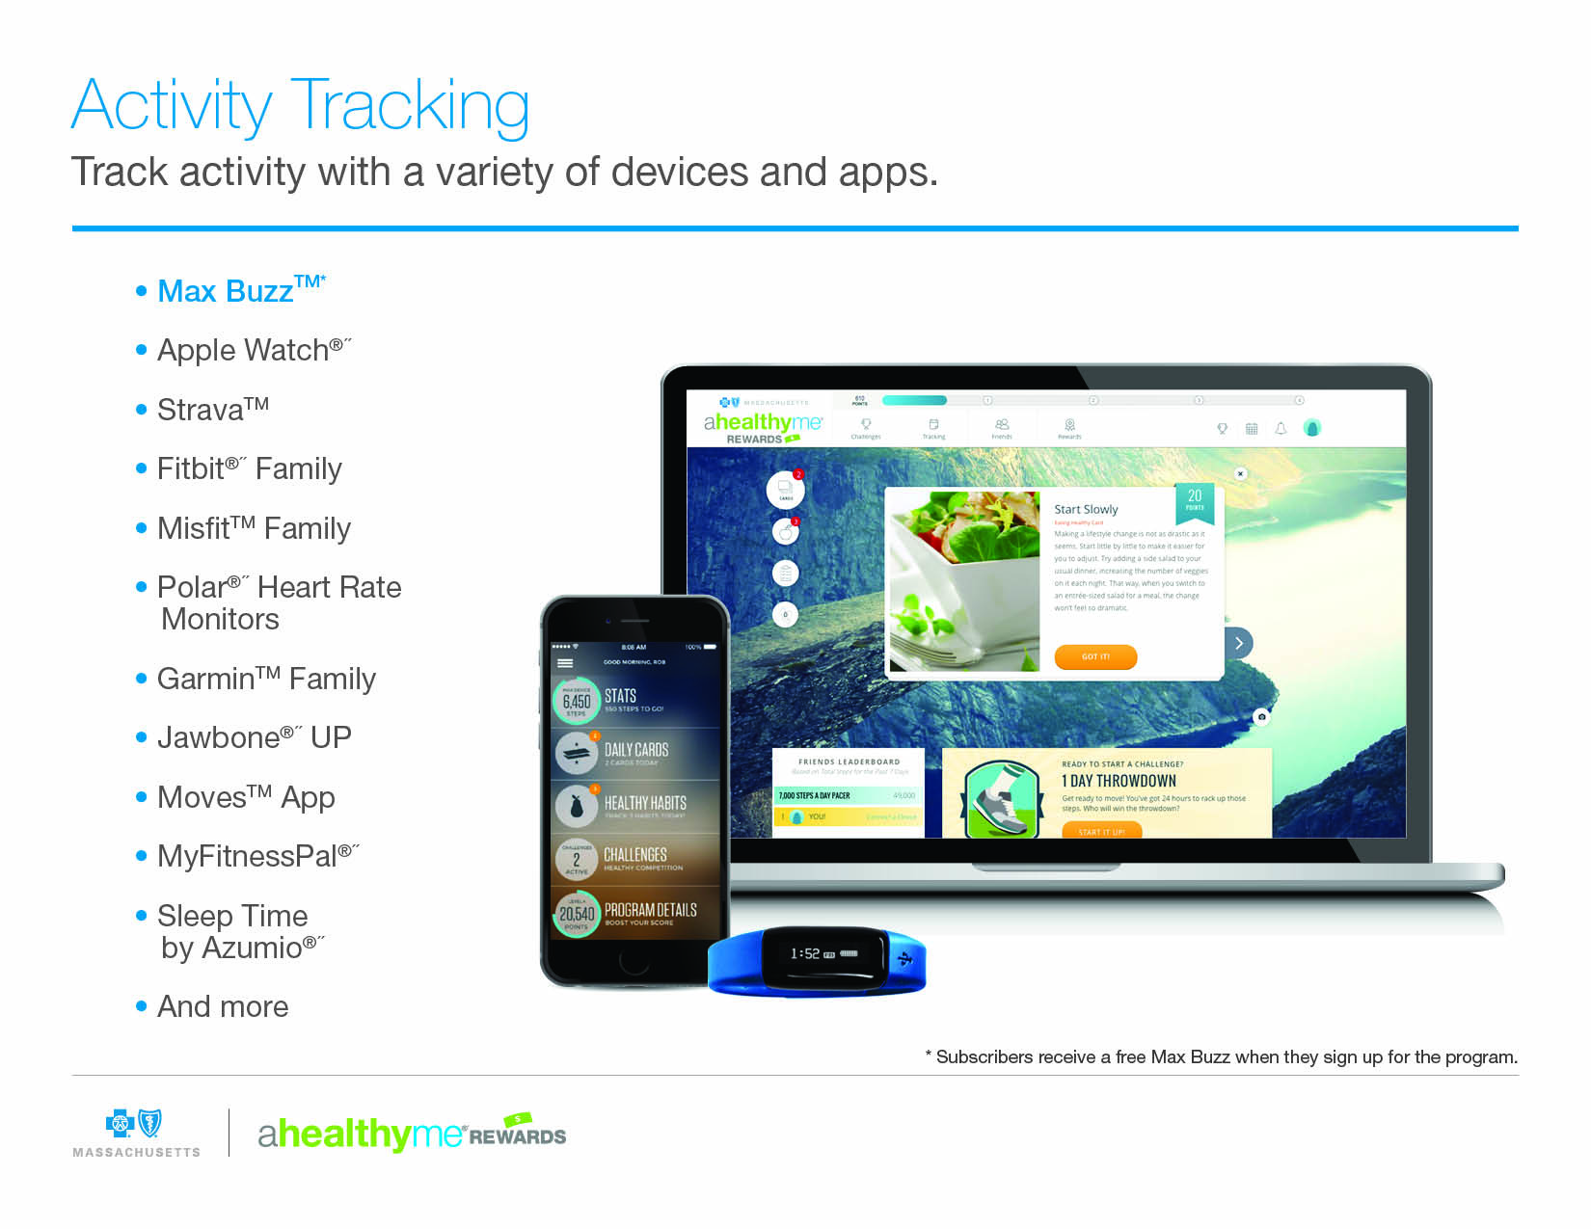
*A Max Buzz™ activity tracker is included with the program for each subscriber.

Slide 10
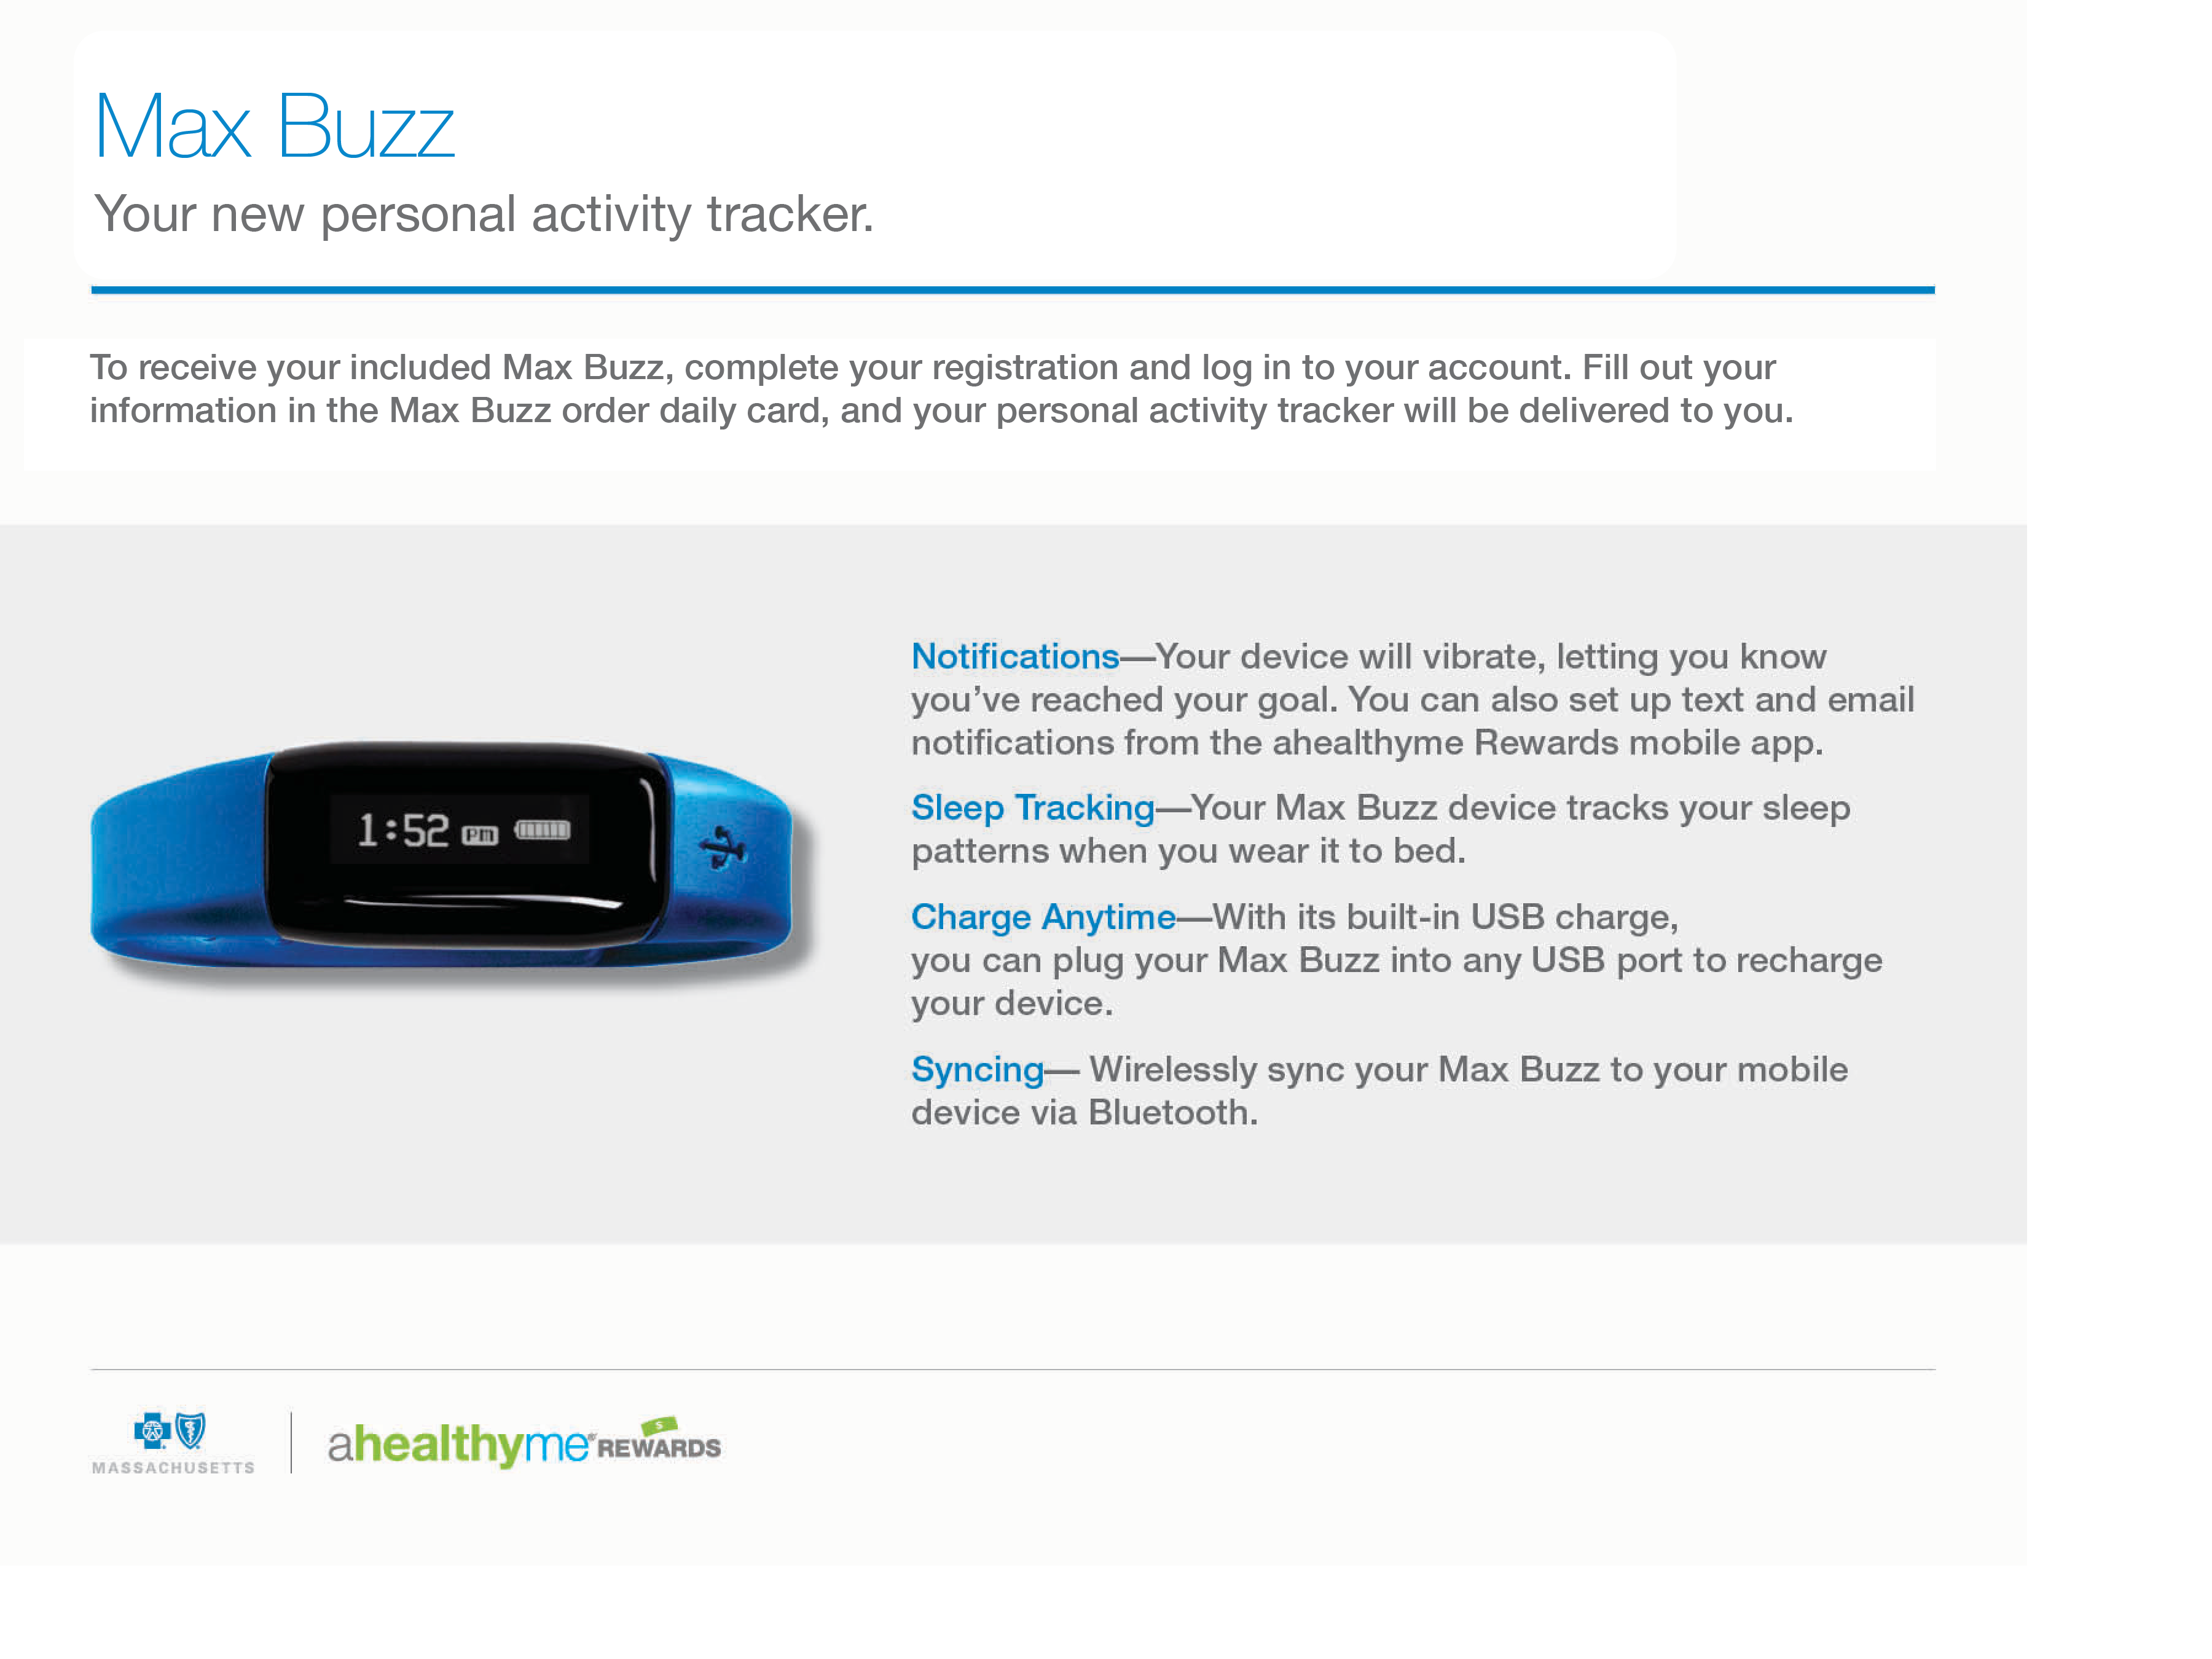
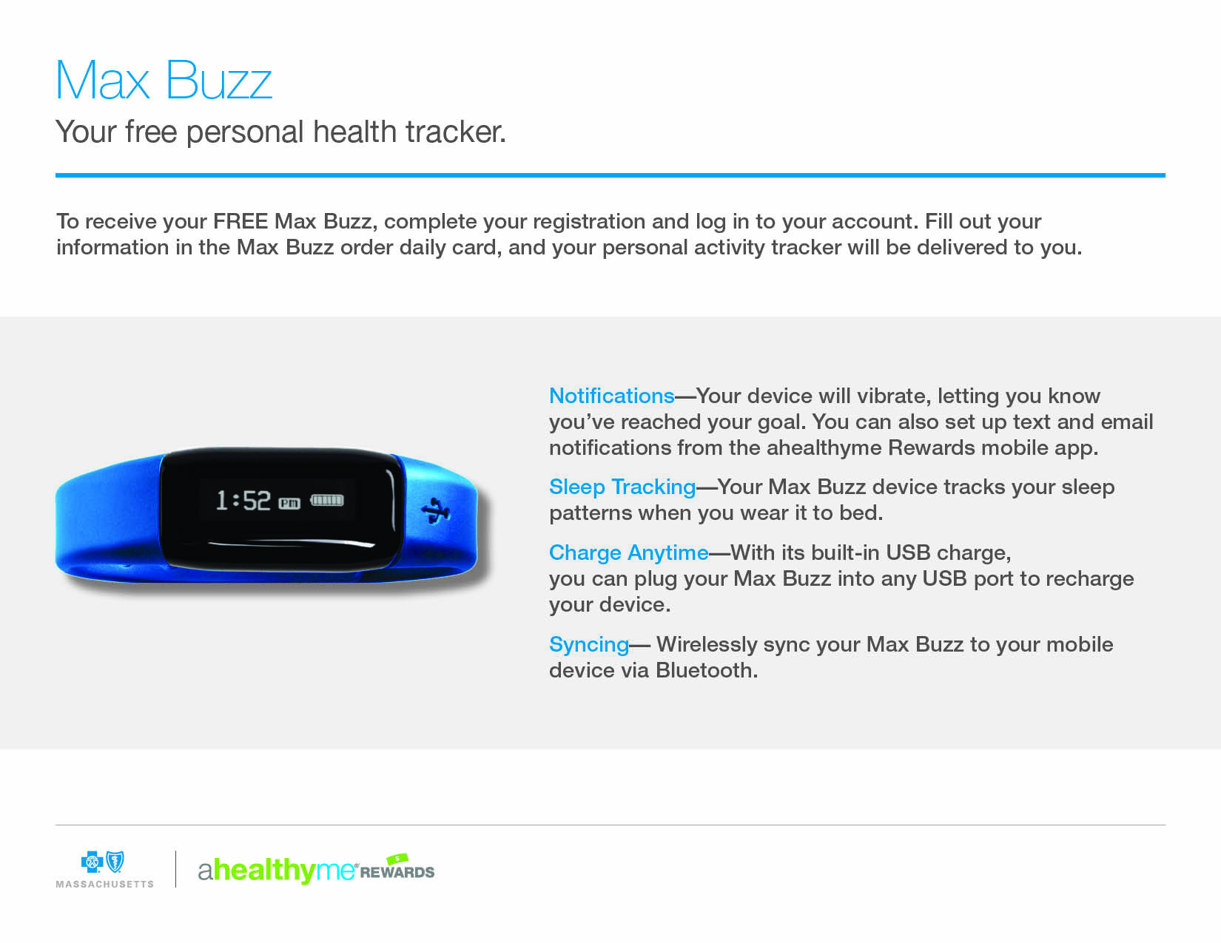

Slide 16
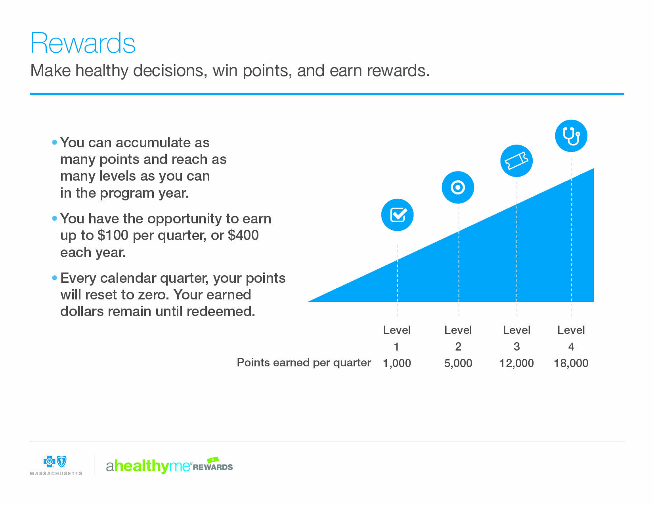

Slide 18
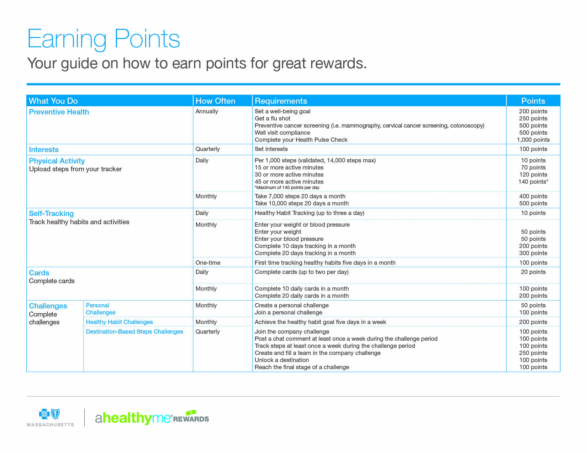
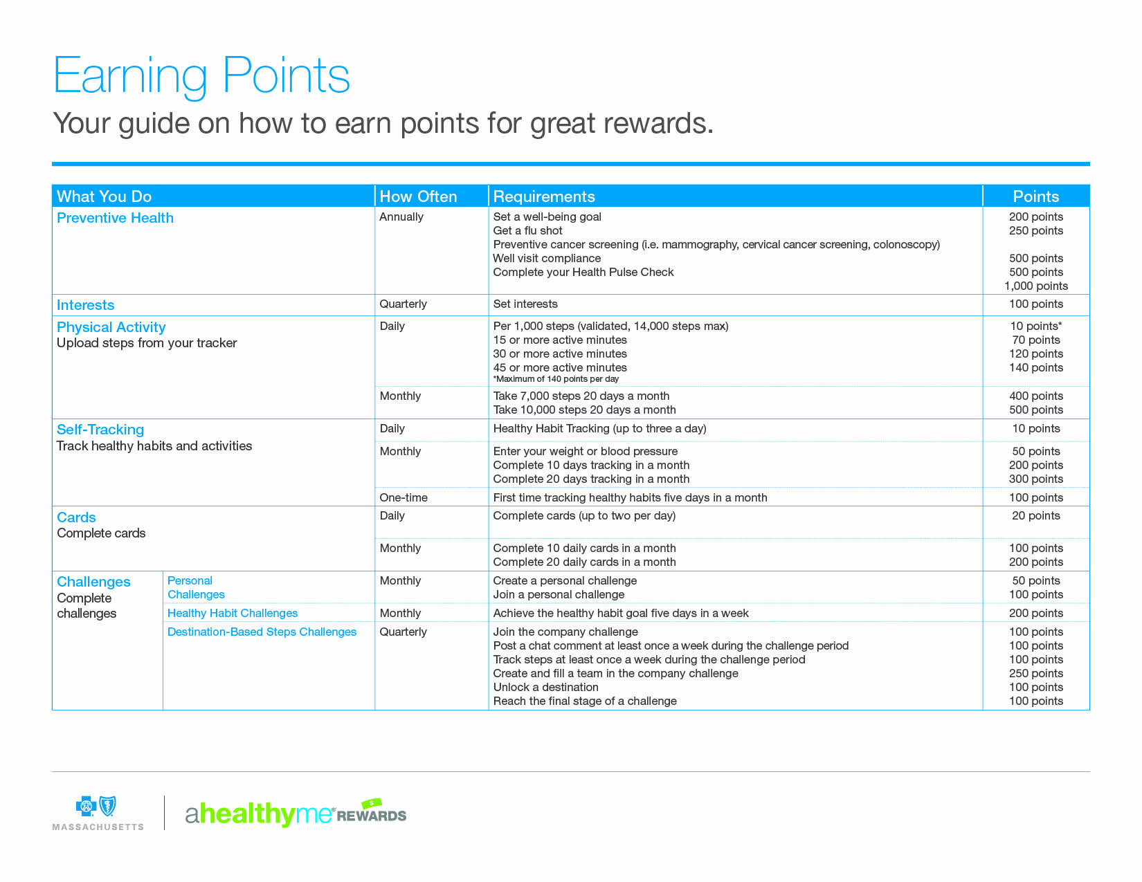
1

Slide 20
1 Reasonable alternatives to those not participating in walking challenges are available, with over 100 ways to earn points.
190277M 55-2099

